Slide 1
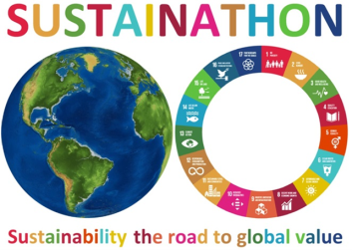
Use of Eurostat Open Data for EU SDG Reporting ‒ Serbia case ‒
Sustainathon 2023
19 September 2023
Vladica Jankovic
Unit for Sustainable Development Goals
and Socio-Economic Indicators

Slide 2
Open data ecosystems
‒ features and possibilities ‒
Access to data sets of statistical indicators collected, verified and published by public authorities: NSOs, Eurostat etc.;
Data are electronically available in machine readable format so that they can be directly used for development of various applications;
Open data encourage the e-Government, national and international policies and reporting at different levels (from country to local level);
Open data are intended for all users: IT professionals, researchers, companies, journalists, government authorities, local governments and citizens;

Slide 3
Eurostat Open data
Eurostat offers access to all their datasets using Eurostat statistics web services.
Users can access the latest version of datasets, being updated twice a day.
This approach is used by Eurostat and many users, for various data visualization and reporting purposes.

Slide 4
EU SDG Profile Creator
This is a free Windows desktop application aimed to create automatically the report (profile) with EU SDG relevant indicators. The application is available at authors web site https://vladica.in.rs;
The application fully explores the Eurostat statistics web services. It requires Windows, Internet connection and Microsoft Excel;
The profile (an Excel file) created by the application contains full set of tables, charts and description for each selected EU SDG indicator and (optionally) the availability statistics;
Users can create profile in four languages English, German, French (Euro base languages) and Serbian (Cyrillic or Latin script), for any combination of indicators, countries, time periods and type of charts;

Slide 5
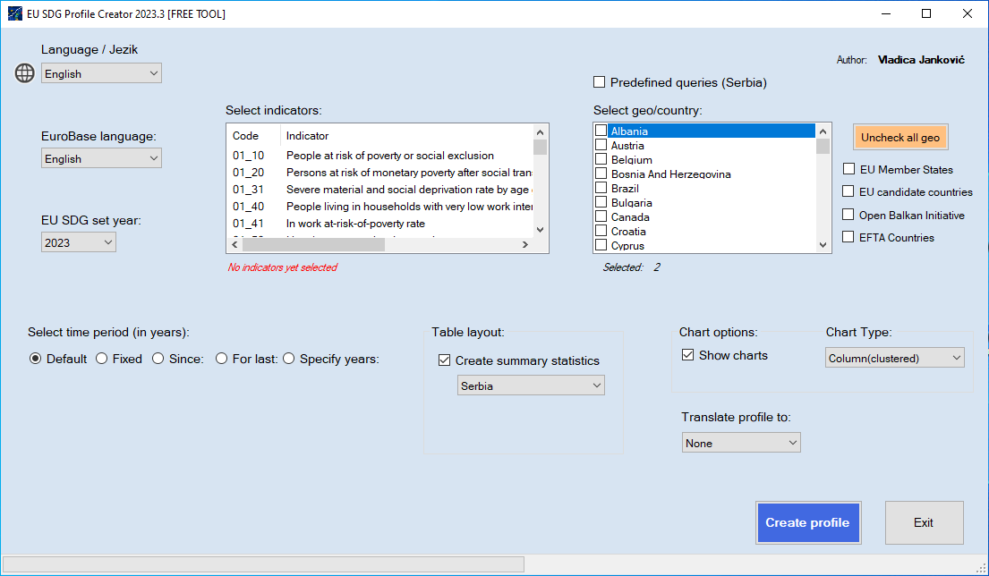
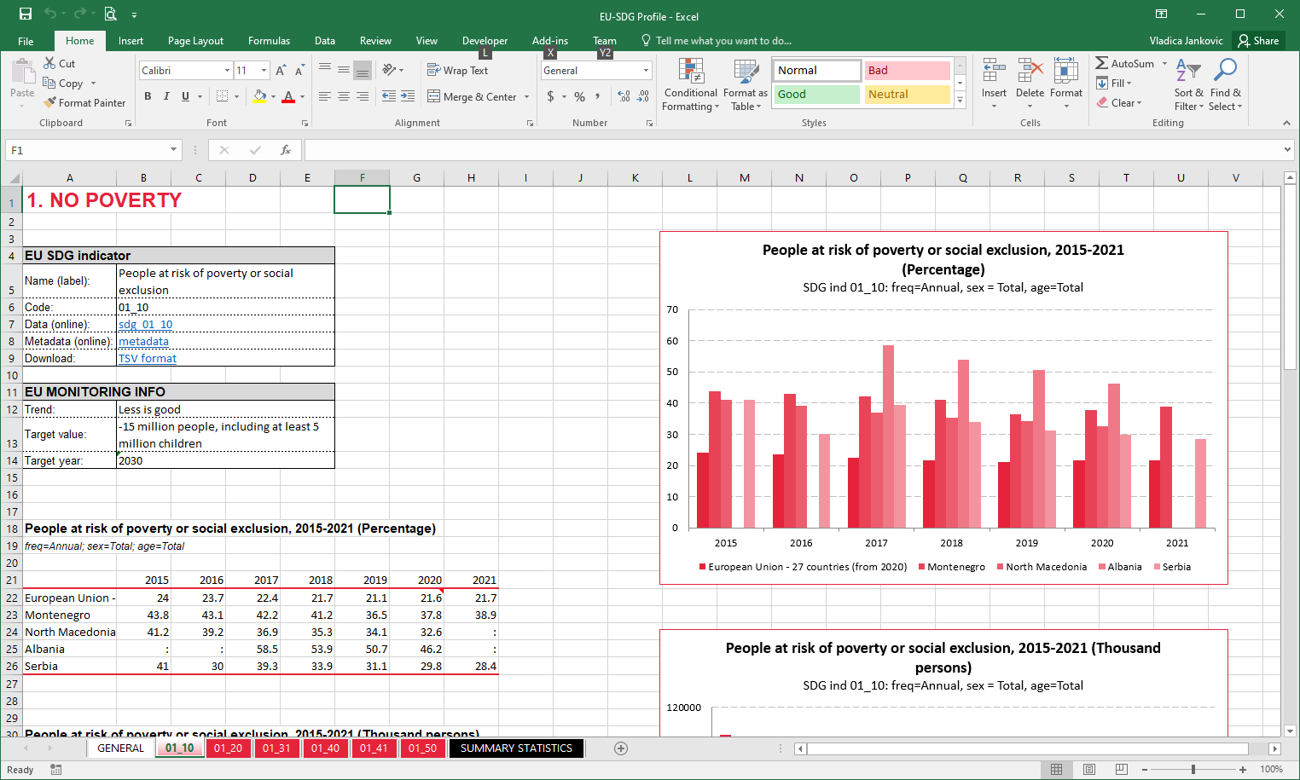
EU SDG Profile Creator

Slide 6
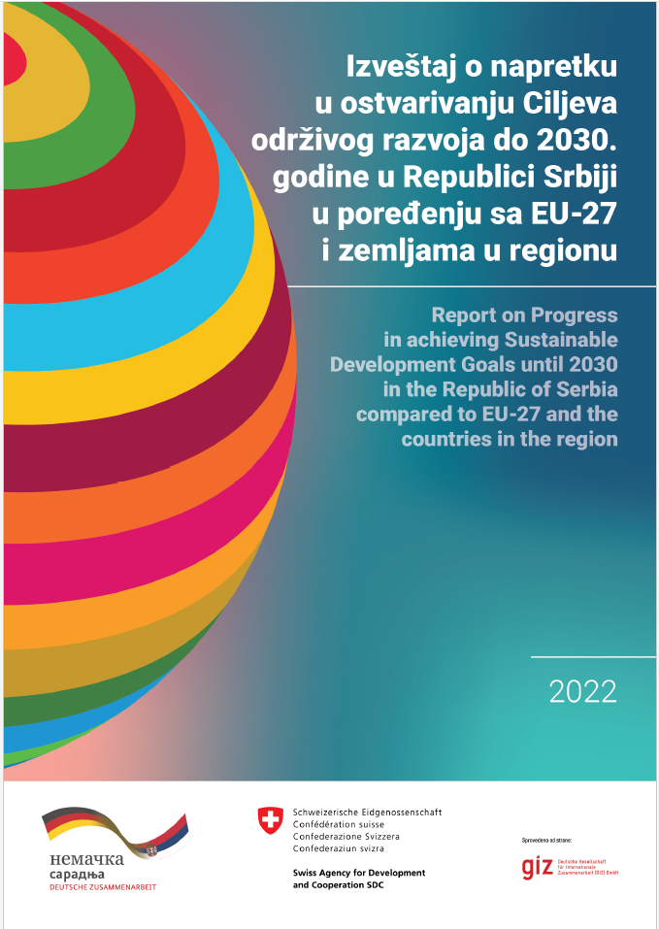
SDG Progress report
Report on Progress in achieving Sustainable Development Goals until 2030 in the Republic of Serbia compared to EU-27 and the countries in the region
This report was initiated by the “Public Finance Reform – Agenda 2030” project supported by the Governments of Germany and Switzerland and implemented by Deutsche Gesellschaft für Internationale Zusammenarbeit (GIZ) GmbH.
The report is available at SDGs4all platform https://sdgs4all.rs/en/documents/
To prepare data and visualizations the EU SDG Profile Creator application was used. The comparison was conducted with the countries in the region, the candidate countries for EU membership: Albania, Montenegro, North Macedonia and Serbia, according to the possibilities enabled by the data availability.

Slide 7
THANK YOU.
Photo 2021

